Slide 1

Ho Chi Minh City University of Technologies
BUILD SMARTHOME SYSTEM WITH RASPBERRY PI
Supervisor
Nguyen Duc Dung
Luong The Nhan
Students
Nguyen Thanh Tam - 51203264
Nguyen Thanh Tung - 51204401
Bui Quang Vinh - 51204518

Slide 2
Contents
Introduction
System’s requirements and overview
Front-end design
Back-end design
Module device controller
Demonstration and result’s estimation
Discussion
Conclusion
References

Slide 3
1. Introduction

Slide 4

1.1. Motivation

Slide 5
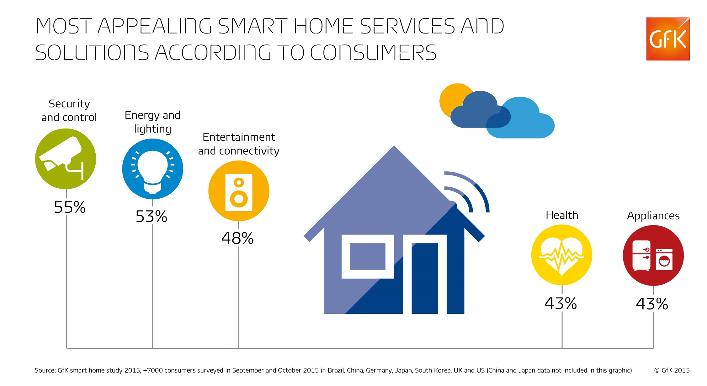
1.2. Top Trends in Smart Home Technology

Slide 6
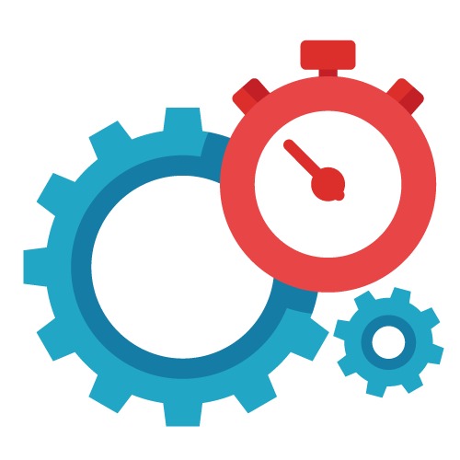
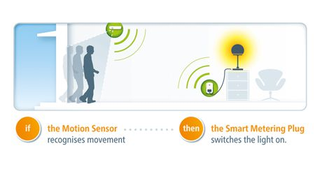

1.3. Target of thesis
Devices operate automatically
Customize home to meet your demands
User uses mobile app to create scenarios for home

Slide 7

1.3. Target of thesis (cont.)
The Raspberry Pi will act as the brains and the gateway of operations, run and manage user’s defined scenarios.

Slide 8

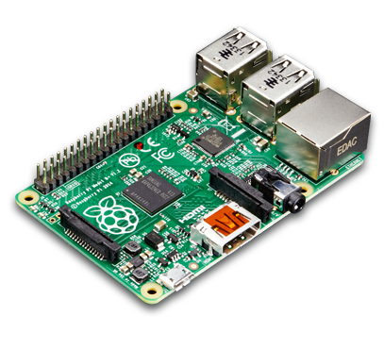
1.4. Scope of thesis
We focus on developing the application, hardware just support
>

Slide 9
2. System’s requirements and overview

Slide 10
2.1. System’s requirements
Functional requirements
Register
Login, logout
Basic actions (add, modify, delete) with home, mode, device, scenario
Non-functional requirements
Decrypt password
Authenticate & authorize user

Slide 11
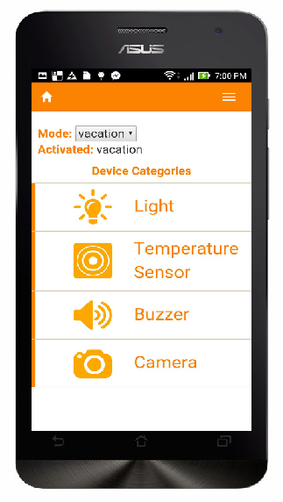

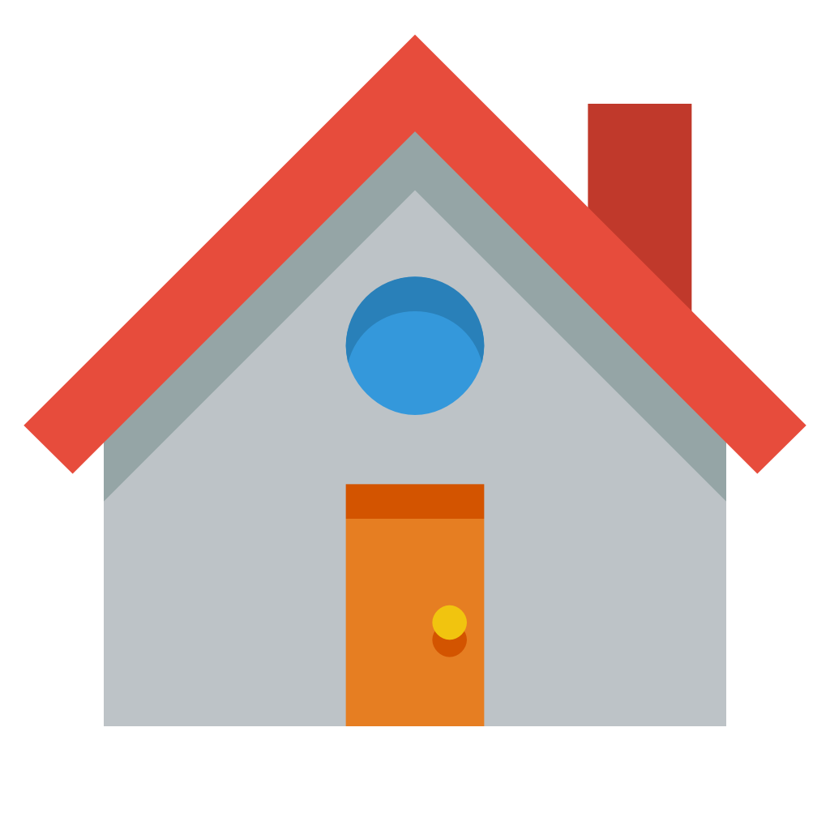
2.2. System’s overview
Send request
Call API
Returned value
Result
Mobile App
Raspberry Pi Server
Device Controller
Get data from sensor
Take action

Slide 12
3. Front-end design

Slide 13
3.1. Functionalities
Manage various device types and modes:
A central place to view and manage multiple
device types in the home
Switching between modes quickly and easily
to activate different scenarios

Slide 14
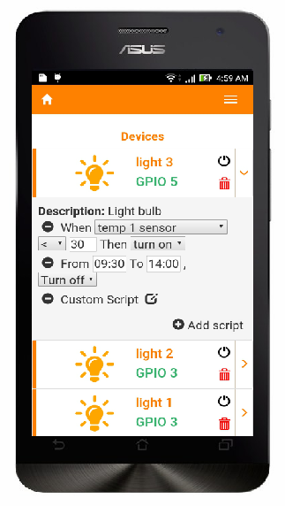
3.1. Functionalities (cont.)
Control devices through customizable scripts:
Easily adding, removing, modifying scripts of
different types for each devices
Combining various scripts in various devices
to produce endless scenarios for home
Controlling home now like writing a story

Slide 15
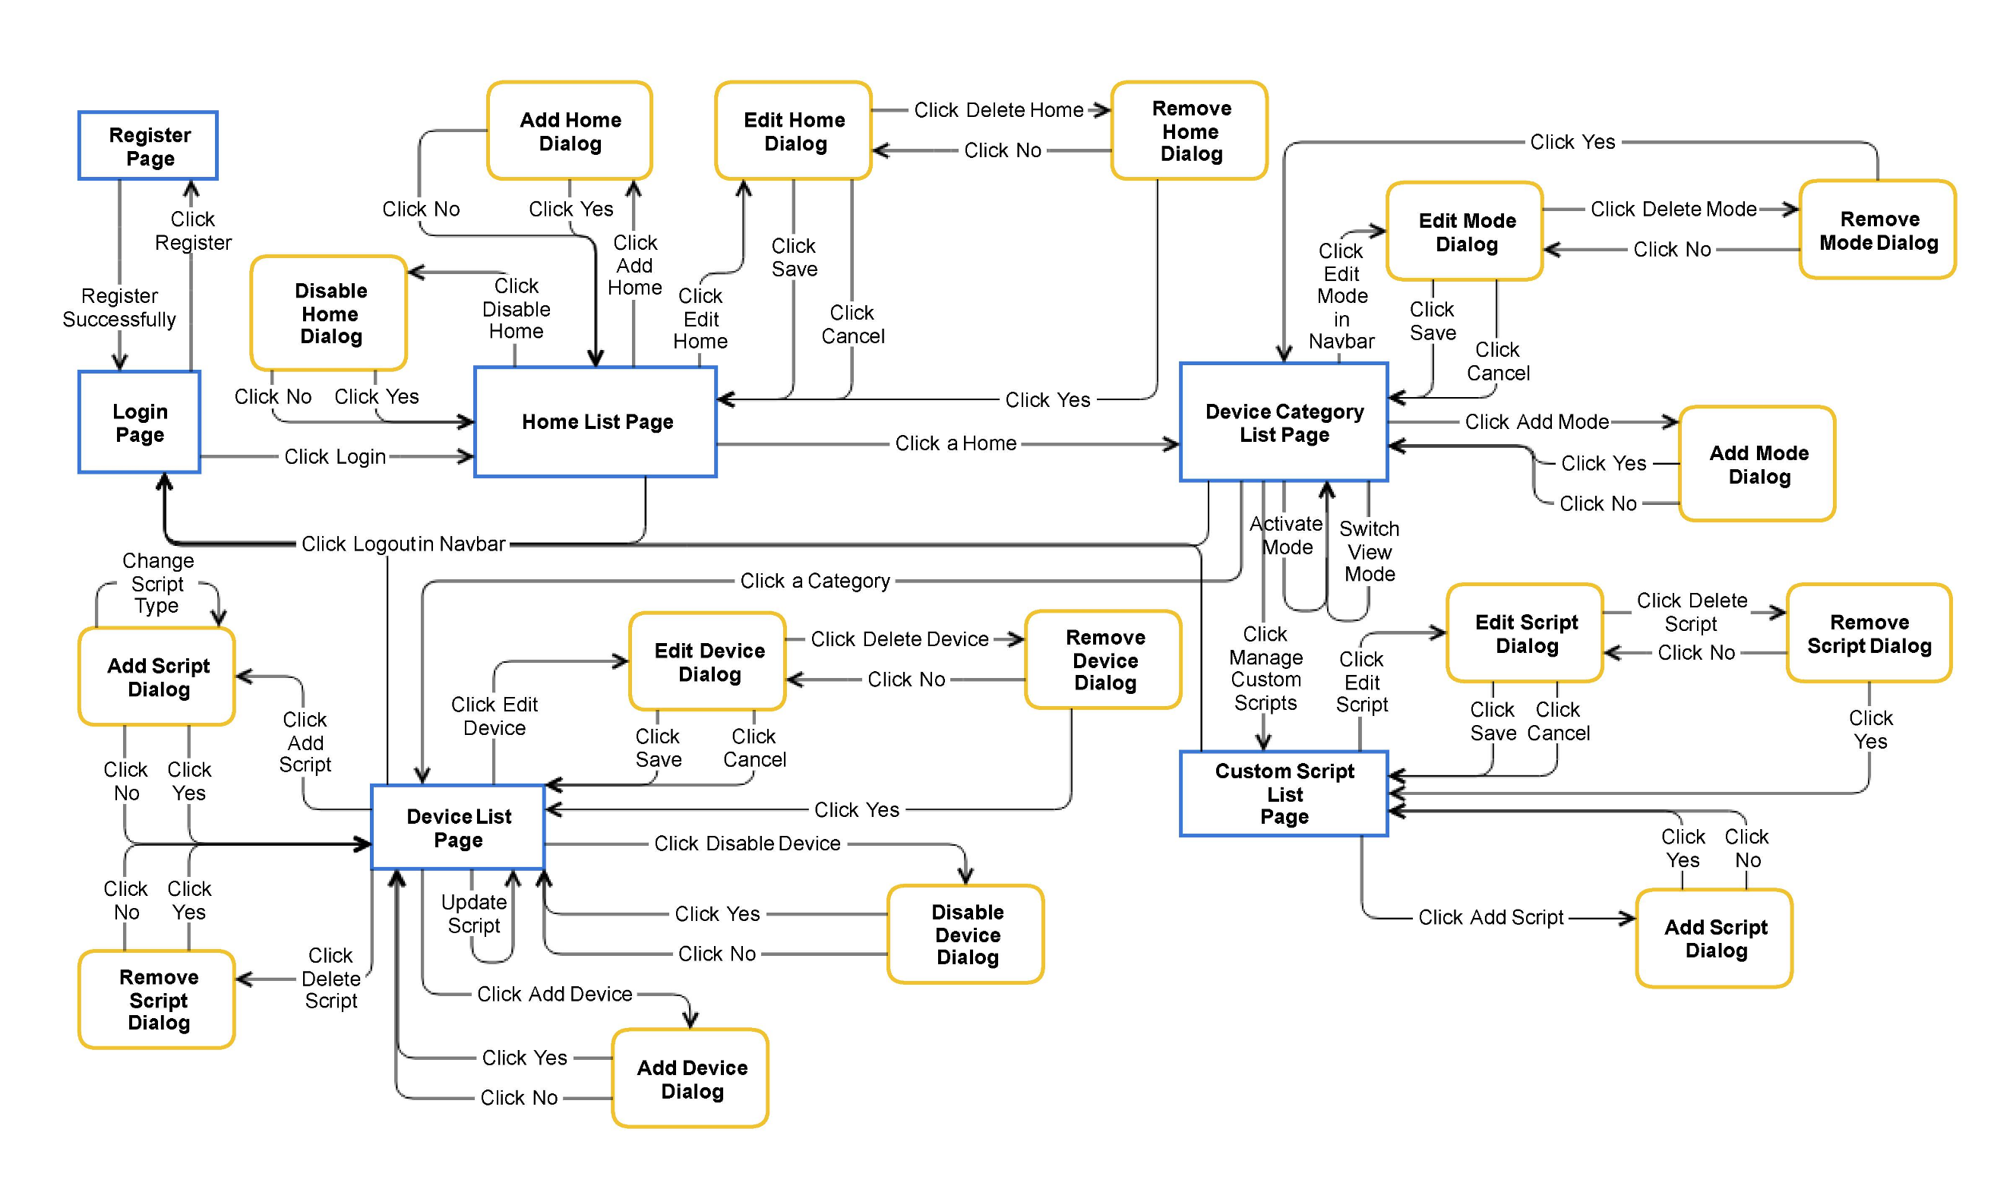
3.2. UI flow

Slide 16
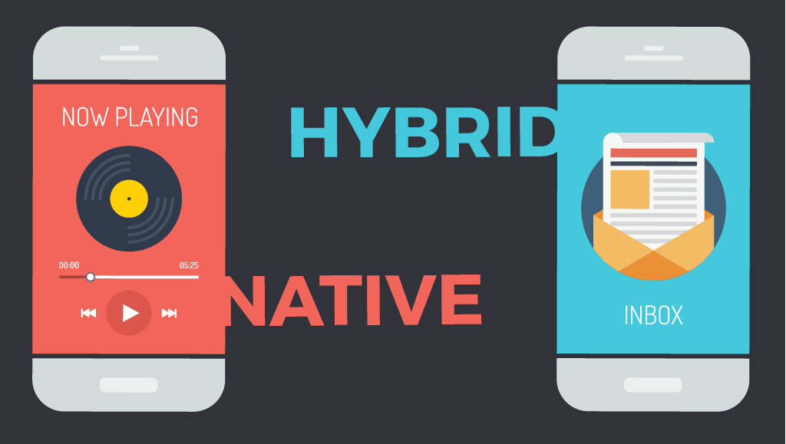
3.3. Native vs Hybrid application development

Slide 17

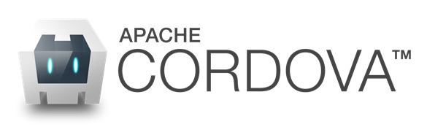
3.4. Front-end technologies

Slide 18
4. Back-end design

Slide 19
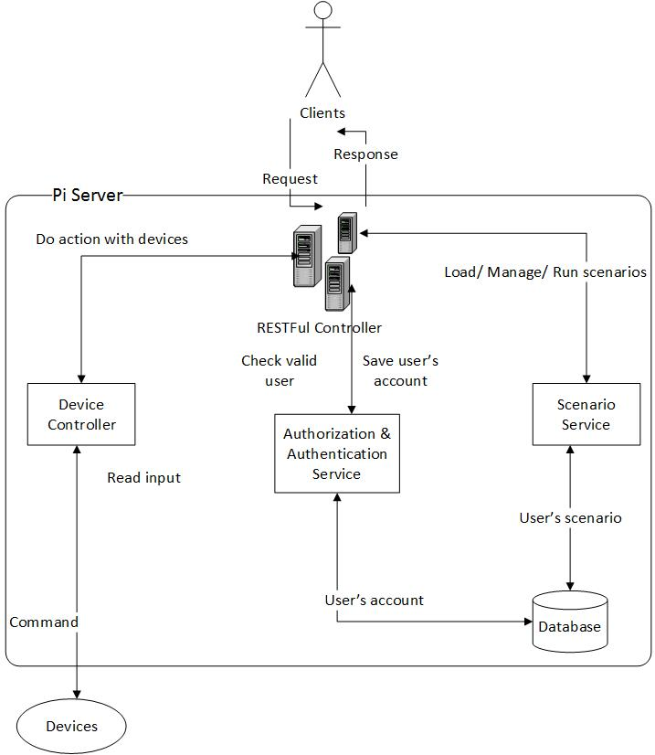
4.1. General picture of Back-end

Slide 20
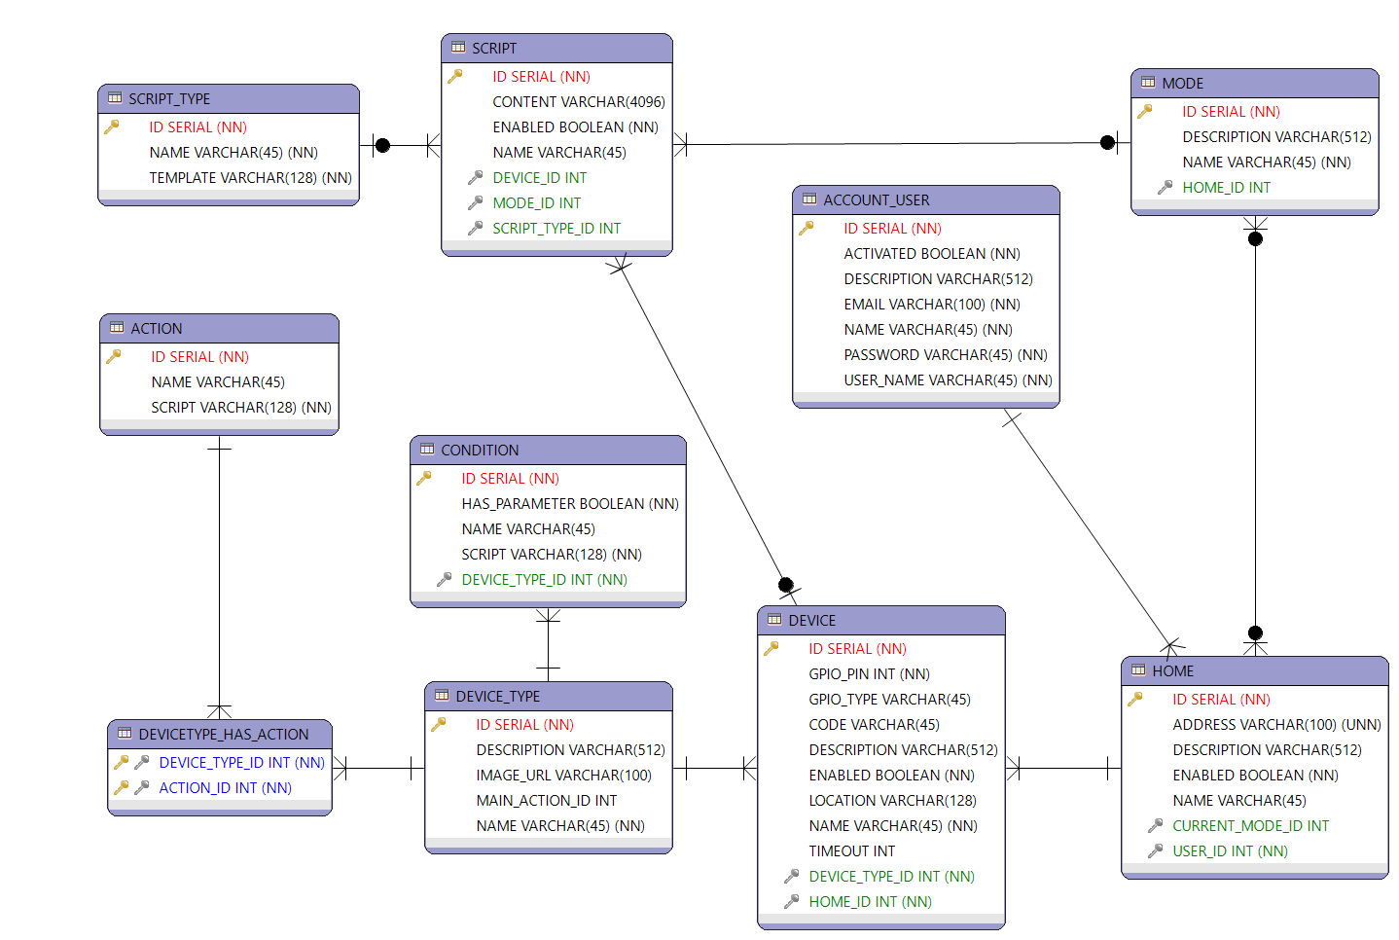
4.2. Database design

Slide 21


4.3. Back-end technologies

Slide 22
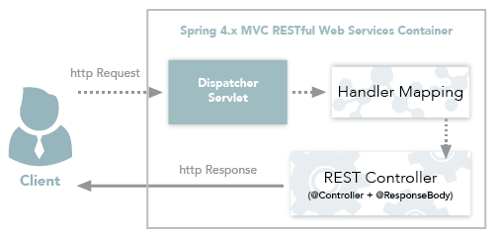
4.4. RESTFul Web Service - Communicate between client and server

Slide 23


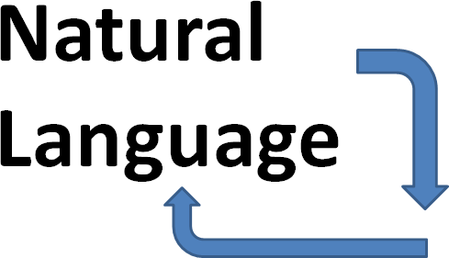
4.5. Concept of scenario
User’s scenario is described in natural language.
Scenario used to store in the database called script.
System “read”, “understand” and run scenario, which is represented by data structure and is stored in the memory of the system.

Slide 24
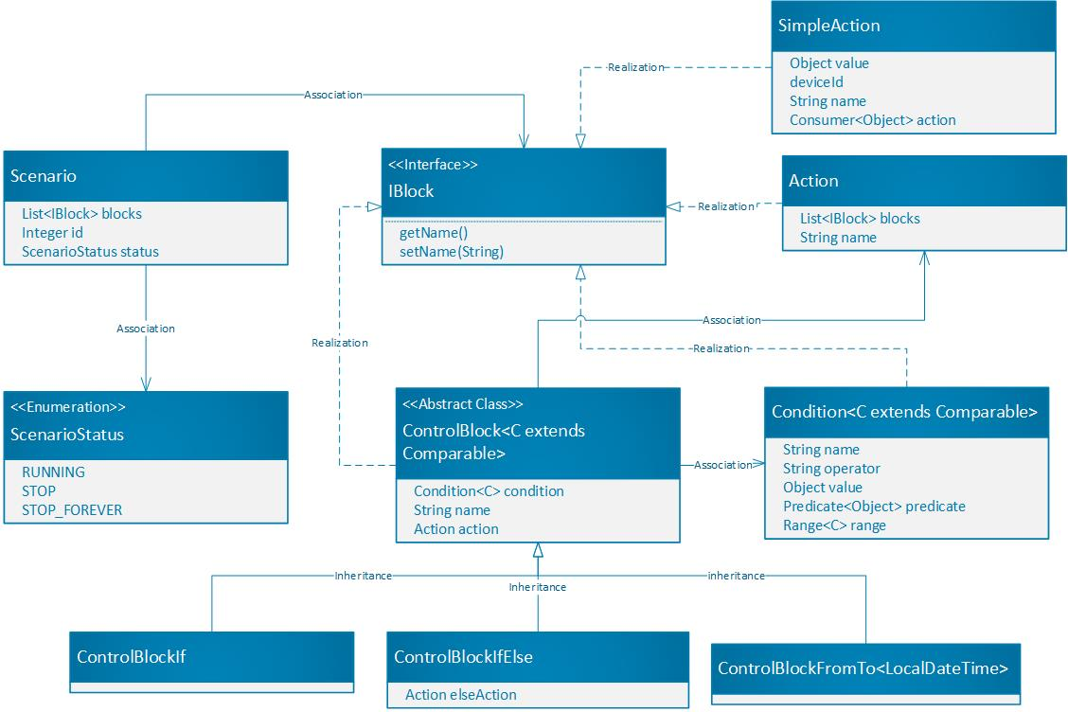
4.6. Data structure of scenario

Slide 25
4.7. Kind of scenarios
3 supported kinds of scenarios
If condition Then action
Ex: If motion sensor detects moving object in front of door Then turn on buzzer
From start To end Do action
Ex: From 17h00 To 23h00 Do turn on light in living room
Custom type (allow nested conditions and multiple actions)
Ex: If temperature between 35 and 45 Then turn on buzzer And turn off light

Slide 26
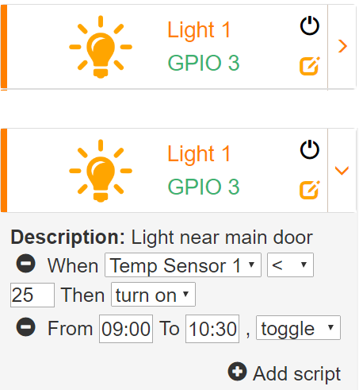
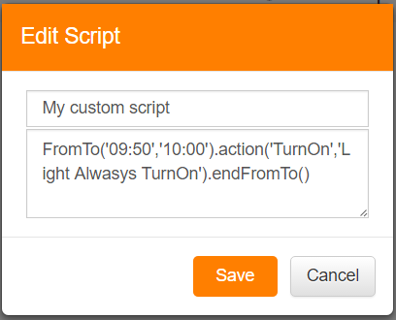
4.8. Input scenarios on real application

Slide 27
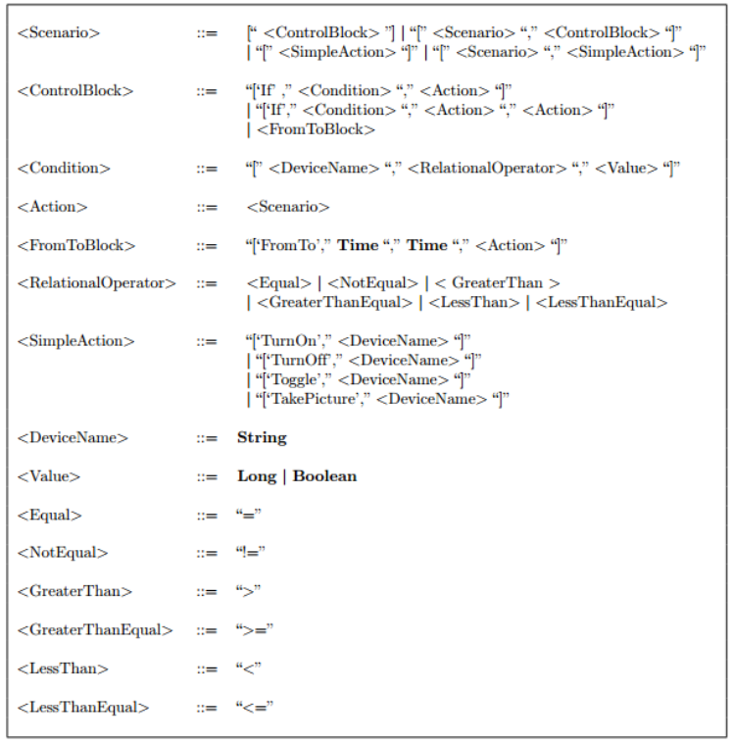
4.9. Syntax for scenario

Slide 28
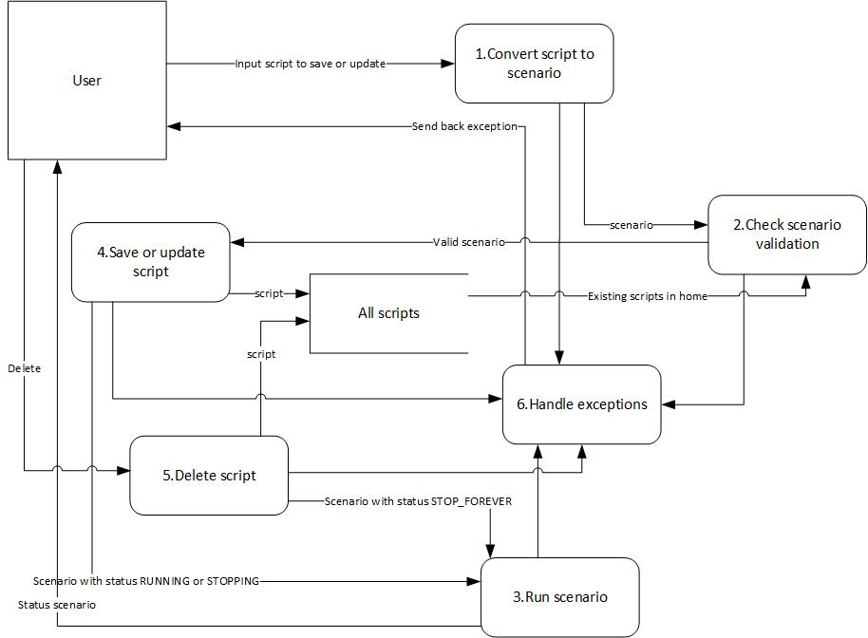
4.10. DFD when add, update, delete scenario

Slide 29
4.11. What is valid scenario ?
Compare to itself: right syntax and not self-conflicted
If temperature is smaller than 30 Celsius then turn off light 1.
If temperature is larger than 40 Celsius then turn on light 1.
Compare to others in same mode of same home:
Not conflicted
Not potential conflicted
Not duplicated scenario
Not same name

Slide 30
4.12. Conflicted scenario
Generally, “same conditions” but counter-action.
For example
If light 1 is on then turn off light 2
If light 1 is on then turn on light 2

Slide 31
4.13. Potential conflicted scenario
Have at least one confliction in scenario and maybe happen in some situations.
From 12:40 To 15:30 then turn off light 1.
If motion sensor detects human in front of door then turn on light 1.
Overlapped time range or value range in condition.
From 12:40 To 15:30 then turn on light 1.
From 15:00 To 17:30 then turn off light 1.

Slide 32
4.14. Scenario Running Strategy
Each scenario is managed by a separate thread.
Server also keep track status of these scenarios
Running: it’s in running state
Stopping: it’s stopping at the moment because of disabling home, device, scenario temporarily
Stop forever: it is not available now and will be remove soon

Slide 33
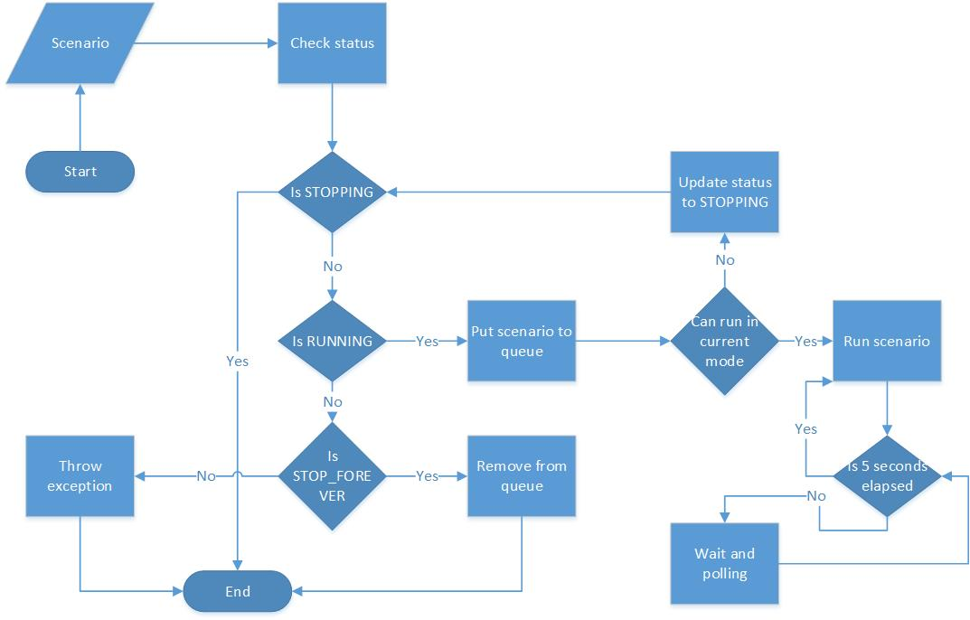
4.15. Scenario Running Strategy - Flowchart

Slide 34
5. Module device controller

Slide 35






5.1. Device controller
Get data from sensors
Send request
Returned value
Raspberry Pi Server
Device Controller
Take action
(turn on/off, ...)

Slide 36
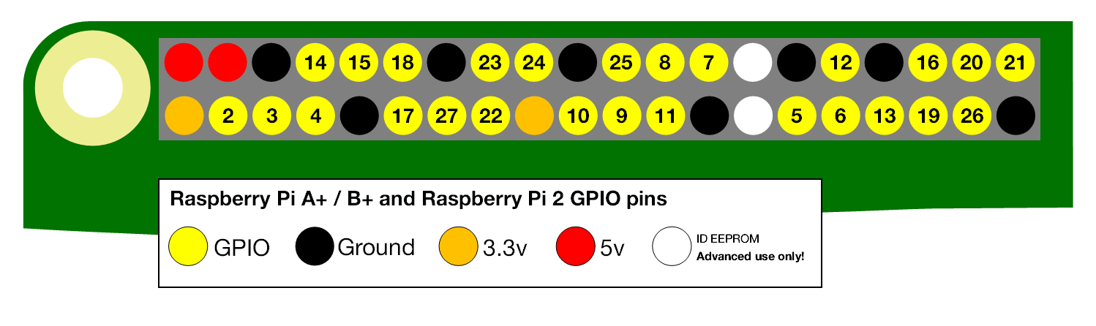
5.2. Device controller
Each device is controlled by 1 GPIO (General-purpose input/output) of Raspberry Pi.
We use Pi4J library to control GPIOs

Slide 37
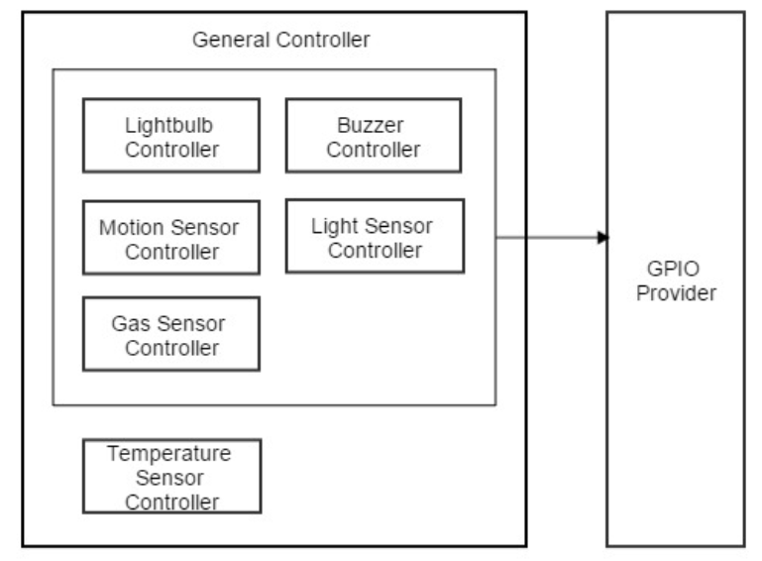
5.3. Device controller – Detail module design

Slide 38
6. Demonstration and result’s estimation

Slide 39
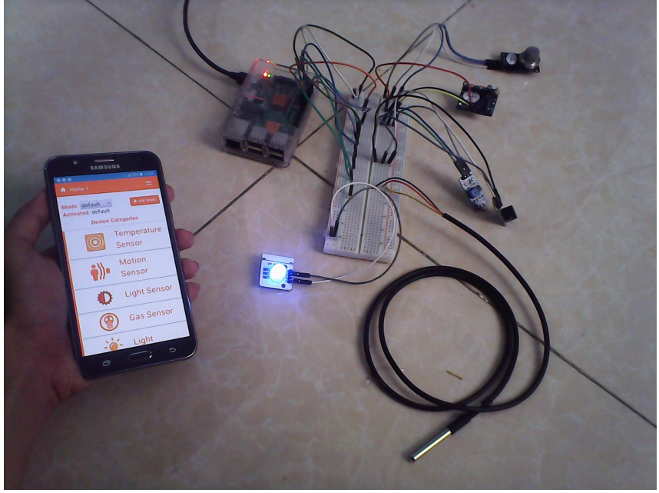
6.1. Demonstration

Slide 40
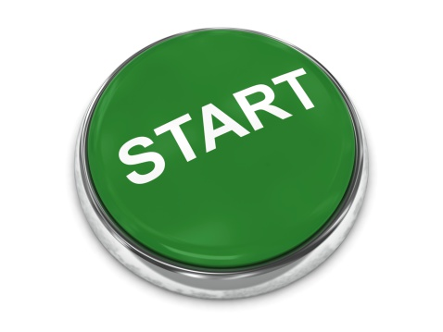
6.1. Demonstration (cont.)

Slide 41
6.2. Estimate system – Good things
From simple to complex scenario can be handled well.
Eliminate correctly scenario that have to be conflicted or potential conflicted with existed ones in same mode.
Only the owner of this home can control one. Otherwise not allow.
Enable or disable home, device cause scenarios start or stop running as expectation.
GUI is simple, provide many functionalities to users.

Slide 42
6.3. Estimate system – Need to improve
GUI is not supported nicely to users for add, update custom scenario.
User’s experience
More choices of conditions, actions, device types, kind of scenarios.
Performance issue when the number of scenarios increase.

Slide 43
7. Discussion

Slide 44
7. Discussion
Find the way to resolve the conflicted or potential conflicted scenarios better
Prior the scenario based on some characteristic.
Default scenarios for some kind of device types.
Optimize the way we operate scenarios using multi-threading.
Cloud service solution for multiple user.

Slide 45
8. Conclusion

Slide 46
8.1. What we have done?
Be able to control devices, sensors via Raspberry Pi.
Can use simple or custom scenario to automate some device’s operation in own home.
Provide GUI easy to use, manage homes, devices, modes, scenarios.

Slide 47
8.2. What difficulties we face ?
Limit the number of devices attach to Raspberry Pi.
User’s experience is not too good, slow respond.
Handle conflicted scenario not good.
The more scenarios we have, the worst the performance goes down.

Slide 48
8.3. The improvement for future
Provide more kind of scenarios with more simpler structure and easier to write.
Handle better conflicted, potential conflicted scenarios.
New solution to manage a large number of scenarios.
Support more kind of devices, such as: camera, door locker,…
Optimize the user’s experience.
Use cloud service to support multiple users.

Slide 49
9. References

Slide 50
9. References
[1] http://www.javadevchannel.com/2015/07/nhung-cau-hoi-pho-bien-ve-spring.html (29/11/16)
[2] https://projects.spring.io/spring-framework/ (29/11/16)
[3] https://www.genuitec.com/spring-frameworkrestcontroller-vs-controller/ (30/11/16)
[4] http://hibernate.org/orm/ (30/11/16)
[5] Alex Rodriguez, 2013. Căn bản về RESTFul Web Services. Trích 30/11/16
https://www.ibm.com/developerworks/vn/library/ws-restful/
[6] http://www.accesa.eu/2015/resources/javafx-and-restful-web-services-communication
[7] http://www.athlsolutions.com/web/ve-chung-toi/tin-tuc-su-kien/xu-huong-tat-yeu-cua-nha-thong-minh . Trích từ nguồn http://www.pcworld.com.vn , tham khảo vào 11/12/16
[8] STAMFORD Conn, 2016. Gartner says worldwide IoT. Trích 25/05/16
http://www.gartner.com/newsroom/id/3291817
[9] http://vinteligroup.com/bai-viet/xu-huong-nha-thong-minh-nam-2016-vinteli-home-41
[10] http://www.toptenreviews.com/home/smart-home/best-home-automation-systems/
[11] http://www.nubryte.com/posts/87-top-4-smart-home-trends-for-2016

Slide 51
9. References (cont)

Slide 52


Slide 53


